Slide 1
Reinforcement Theory of Motivation
Name:
Institution:
Course:
Date:

Slide 2

Summary of Case
The target behavior for this experiment was the participant’s behavior
The behavior was linked to negative outcomes will not be likely to recur.
Negative behavior entails things that are disliked by parents or teachers.
Use of both positive as well as negative reinforcement ensured a higher likelihood of a positive response.
Positive reinforcement occurred where the participant did not isolate himself.
Negative reinforcement occurred when the participant isolated himself.
Notes:
The target behavior in this case was the participants behavior. The experiment was meant to encourage positive response which was made possible through the reinforcement theory of motivation.

Slide 3
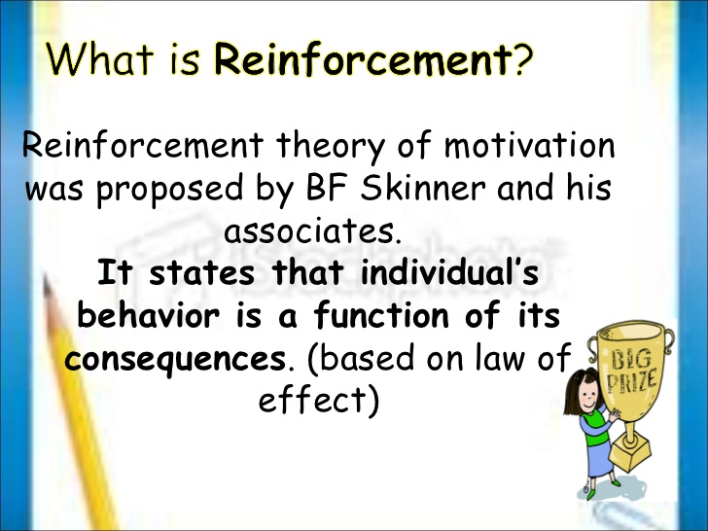
Literature Review
Positive reinforcement are meant for encouraging a desired behavior.
Negative reinforcement is meant to discourage the outcomes or response that is not desirable.
Positive reinforcement increases the frequency of a behavior via the contingent presentation of a pleasant response (Gordan & Amutan, 2014).
Negative reinforcement increases the recurrence of a response via the removal of an unpleasant consequence.
Notes:
Reinforcement theory of motivation is meant to encourage the behavior that is desired. The experiment induced certain consequences so that it can attain the desired results. Positive reinforcements increases when the recurrence of a desired response, whereas negative reinforcements are induced in order to prevent the recurrence of a certain unpleasant consequence (Gordan, et al., 2014).

Slide 4

Baseline Phase
Target behavior: Isolation is a state whereby a person feels being left out from the rest within the society.
Observation process: the observer was the person who was monitoring the participant .
The observer kept a close eye in order to note when the participant was isolated and when was not.
The behavior was observed and recorded for seven days.
The participant did not notice whether he was being observed.
The observer recorded the frequency of the target behavior.
Dimensions Recorded: isolated and not isolated.
Notes:
The behavior that was targeted was that of isolation. Isolation occurs when an individuals feels being left out within the society. The observer kept a close eye to the participant in order to note the frequency of the behavior under study.

Slide 5
treatment Phase Graph
Notes:
The graph shows the frequency of occurrence of the target behavior against the number of days when the study was been carried out.

Slide 6

Treatment for Isolation Behavior
Treatment Method: positive reinforcement
  The participant was congratulated or given prizes when he failed to isolate himself from the rest.
  The observer used continuous positive reinforcement.
  Negative Reinforcement
  The observer, the parents as well as the teachers did not give the participant a prize or even congratulate him.
Notes:
The treatment phase involved positive and negative reinforcement. Positive reinforcement took place when the participant showed the desired behavior, whereas negative reinforcements were also meant to encourage the desired behavior.

Slide 7

Results of the Isolation Experiment
Positive reinforcement method was effective in decreasing incidences of isolation during the experiment.
During the first day, the participant showed only 10 incidences of isolation.
The second day the isolation incidences dropped up to 6 times.
From the third day to the seventh day, there was recorded only one incident of isolation.
Negative reinforcement method was also effective.
The participant was not given any prize and was not congratulated.
Notes:
Positive and negative reinforcement methods appeared to be effective since the incidences of isolation reduced progressively.

Slide 8
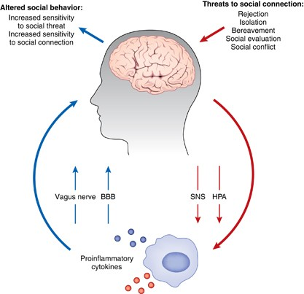
Limitations and Recommendations
The participant should never realize that he or she is been observed.
If the participant realizes that he or she is being observed, he or she might fake the desired behavior.
The observations should be recorded as they occur in the respective columns.
The observer, parents and teachers should use both positive and negative reinforcement methods.
Positive encourages a certain behavior.
Negative reinforcement employs withdrawal of a certain thing in order to cultivate for the desired behavior.
Notes:
The participant should not be allowed to notice if he or she is been observed. the use of both positive and negative reinforcement methods were employed in order to cultivate for the desirable behavior.

Slide 9

Conclusion
The target behavior was isolation.
The observer was to keep a close eye to the participant.
Both positive and negative reinforcement methods were employed.
Both methods were meant to encourage the desired outcome, bringing to an end the behavior of isolation.
Both methods appeared to be effective since the behavior of isolation was ended.
Notes:
The behavior that was targeted in this case was that of isolation. Both positive and negative reinforcement methods were employed in the study and they appeared to be effective.

Slide 10
Reference
Gordan, M., & Amutan, K. I. (2014). A Review of BF Skinner’s ‘Reinforcement Theory of Motivation. International Journal of Research in Education Methodology, 5(3), 680-688.

